Slide 1



BIG DATA PROJECT
Notes:
Good Afternoon! We are group 7 and these are our team members.

Slide 2
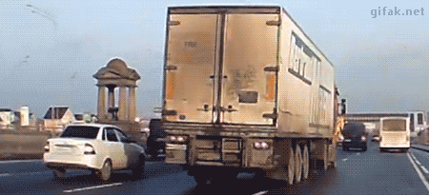
Case Scenario
AZ National Trucking (ANT) is a fictional national trucking corporation headquartered in California. It is a 10-year-old organization with 400 employees, most of whom are long-distance truck drivers. ANT’s primary business is to provide long distance trucking services of all general and non-specialized cargo types.
Notes:
We are a trucking company based in California with 400 truck drivers as our employees and our goal is to provide long distance trucking services

Slide 3

Problem Statement:
As the fleet managers of AZ National Trucking Corporation, we are in charge of ensuring that all the drivers in the fleet are in compliance with the rules and regulations of the corporation and do not present an insurance risk due to factors including :
Speeding
Unsafe following
Lane departure
Other unsafe driving practices.
Objective:
To reduce the risk of accidents among drivers by:
Analyzing and identify dangerous truck drivers
Highlighting drivers with risk factor greater than or equal to 7.0

Slide 4

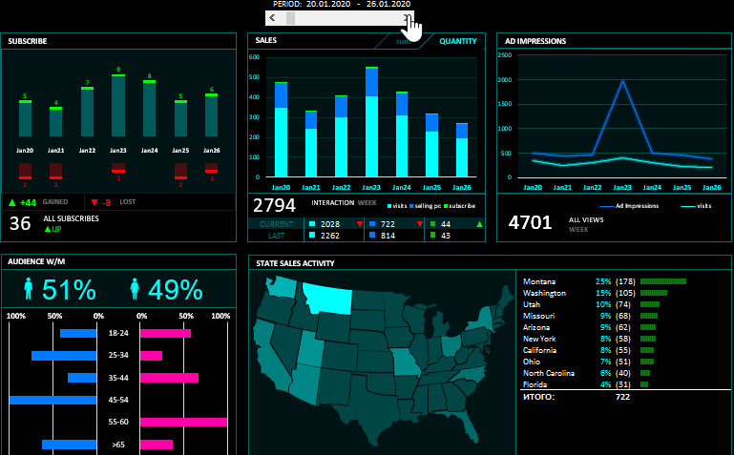



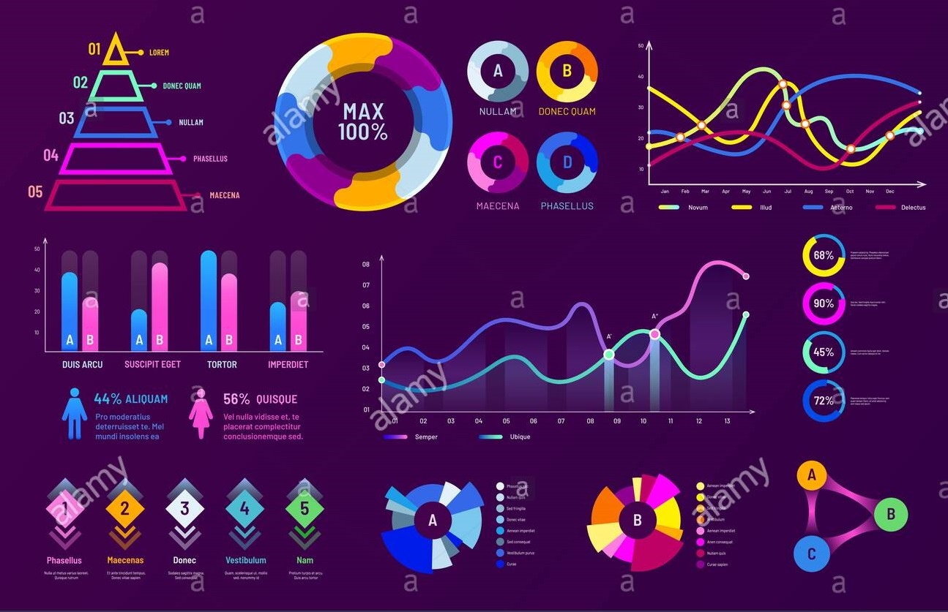



Process Flow
Download the data
Performing Exploratory Data Analysis
Trucks and Geolocation CSV files loaded into HDFS as tables
Create an interactive visualization dashboards in Tableau
Move files from local system to HDFS using SCP command
Import data into Tableau using Impala JDBC driver
Create tables in Hive writing Hive queries
Hive
Impala
Pig
Cloudera Server
Import data in Impala using LOAD DATA INPATH command

Slide 5
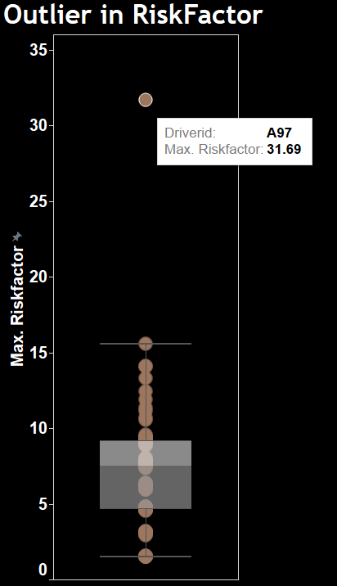
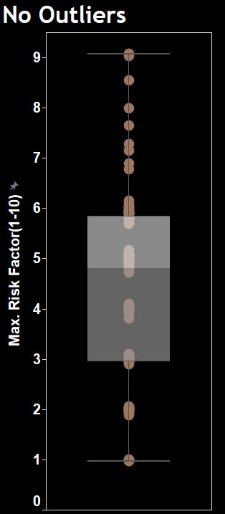
Data Analysis
DriverID A97 has a risk factor of 31.69 which is an outlier
To avoid skewness and to bring the Risk Factor values between 1 - 10, the outlier is removed, and scaling is done
Though driver A97 is an outlier, independent in-depth analysis has been done

Slide 6
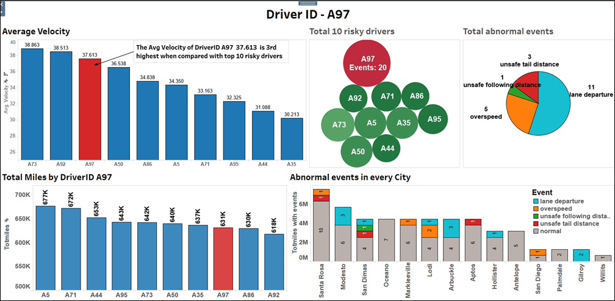
Outlier Analysis - Driver ID A97
Driver A97 has avg velocity greater than most top risky drivers
A97 did not comply with rules and has posed risk with all factors such as with speeding, lane departures etc.,
A97 cannot be claimed as new or inexperienced driver since he had driven around 632k miles and in many cities
Recommendations:
Thus, A97 should be given a warning once but if he still persists to be a risky driver then he should be removed from the fleet

Slide 7
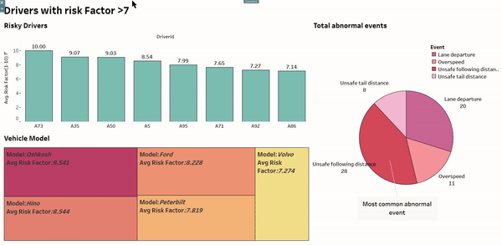
Analysis of Drivers with Risk Factor >7
In the plot by clicking on the bar of each risky driver, their corresponding abnormal events and vehicle model can be seen
There are 8 drivers with risk factor>7 who are A73, A35, A50, A5, A95, A71, A92 and A96
Recommendations:
These drivers should be considered as “RISKY” by the organization. It would be a good idea to keep them under probation and monitor them closely

Slide 8
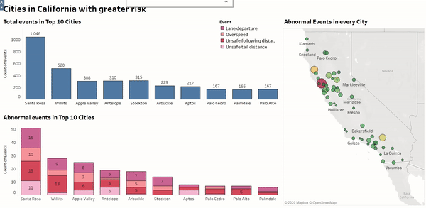
Cities in California with Greater Risk
This plot displays the top 10 cities in california with highest events
The City with the highest number of abnormal events is “SANTA ROSA”
Future scope:
The City with the highest number of abnormal events is “SANTA ROSA”. But why ?
Are the roads in santa rosa in bad condition ? Or does it have anything to do with speed limits that has been set there? These questions can only be answered with further analysis which would be the future scope of this project

Slide 9
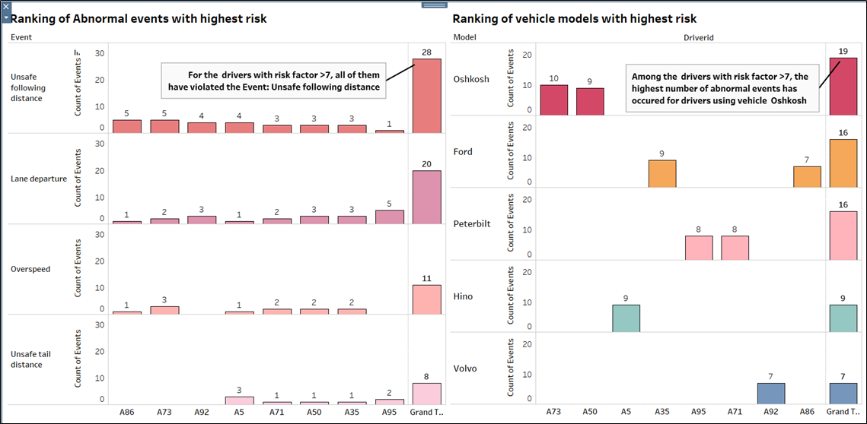
Most risky event and vehicle model
First chart displays the most common abnormal event among the risky drivers
Image 2 displays the vehicle model of most risky drivers
Suggested Actions:
Since it is evident that all risky drivers has “unsafe following distance” as one of their abnormal events, mandatory training has to be given to follow safe distance while driving. Also, further analysis on if any correlation exists between vehicle model Oshkosh and abnormal event needs to be done

Slide 10
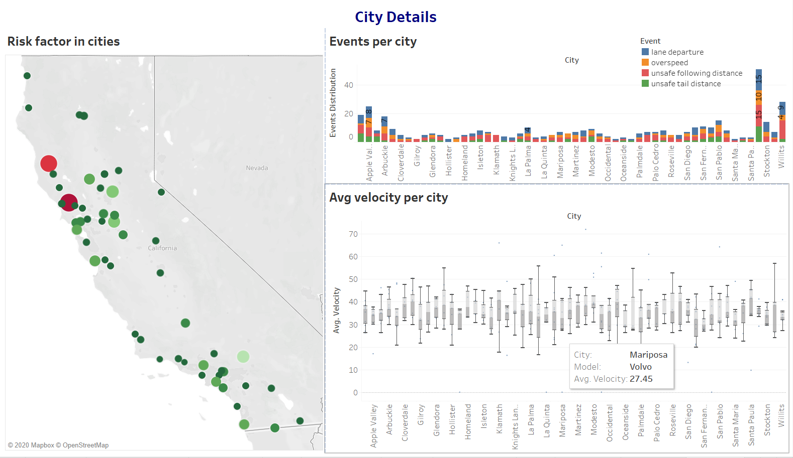
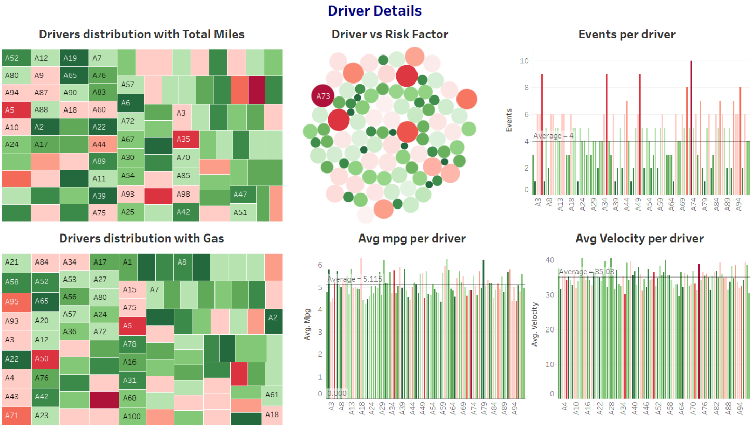
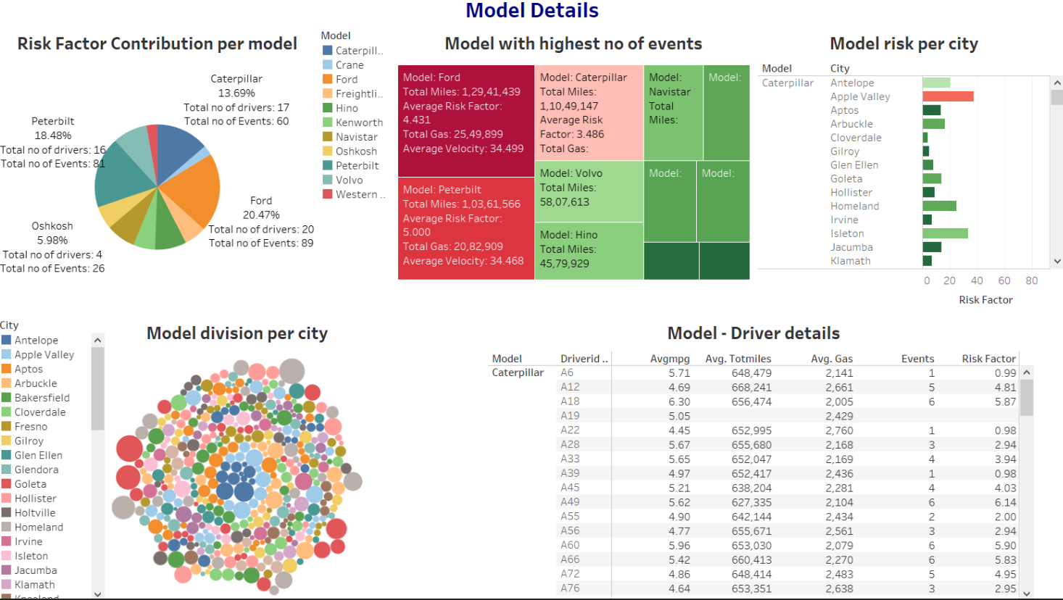
App for Managers

Slide 11
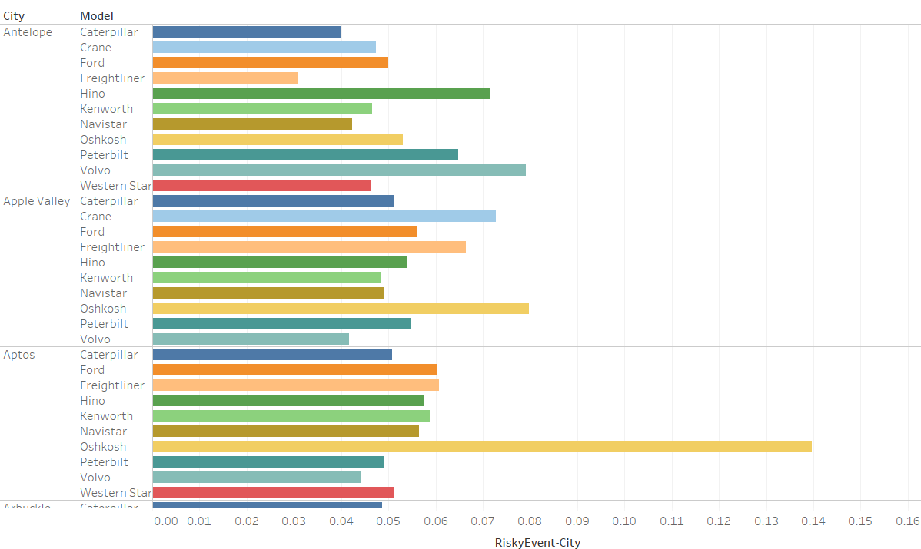
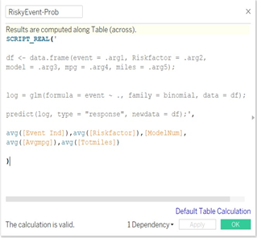
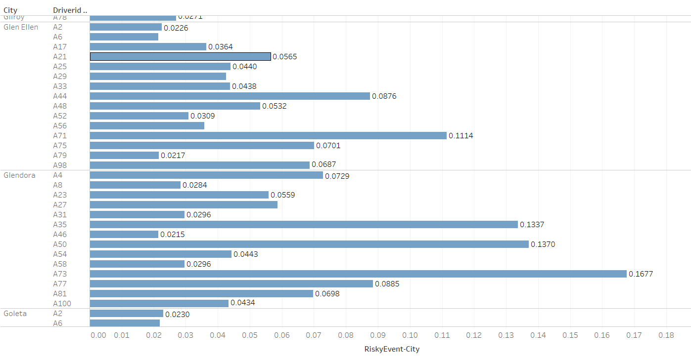
R INTEGRATION

Slide 12


